Slide 1
EHRS GETS THE POINT!
An information evening for parents on collecting CRP points for
Nursey and Reception Jewish School applications 2024-25

Slide 2
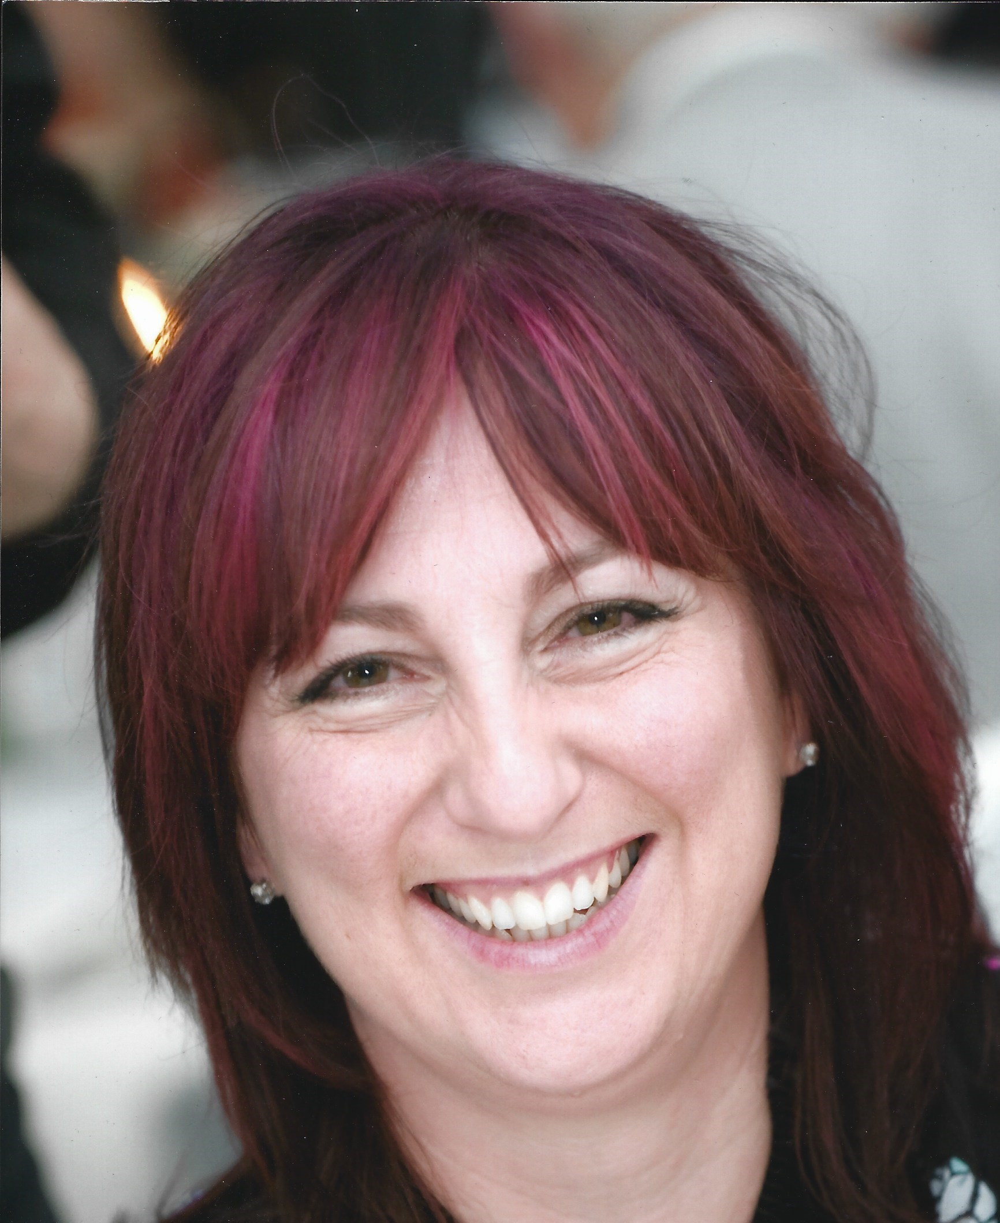
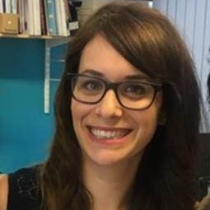
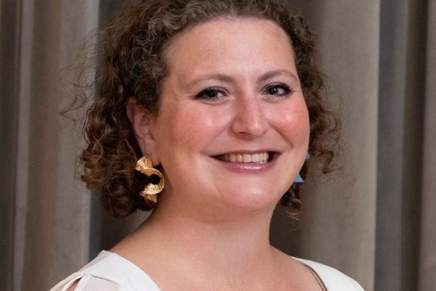
Welcome & Introduction
Milissa Seiler MA – Head Teacher Nagila Nursey
Sarah Koster –Young Families Lead (Sinai parent)
Rabbi Debbie Young – Somers (Yavneh Parent)

Slide 3
The how tos for EHRS collection
Jewish day schools all require the completion of a CRP (Certificate of Religious Practice) form for admission which is dependent on collecting points for service attendance, Jewish education or volunteering in the Jewish community. Each school has its own unique requirements.
Registering - We ask you to register with Guy Ronen in the EHRS Education team (education@ehrs.uk or 0208-238 1012) that you are collecting points through EHRS and then he will support you with keeping a record of these attendances and assign a record card.
Attendance - We are very happy to help you collect CRP points to confirm you have attended services at EHRS. We will ask you to collect stickers for services attended in your child’s individual record cards. This will be given to you at your first attendance, then kept at the Shul for safe keeping! This will also be engaging for kids to collect and fill up their records.
Signing off - The final stage is to get back in touch with Guy who will arrange for you to meet with one of our Rabbis who will use this record card to confirm your attendances required by the schools and will be delighted to speak with you and sign your form!

Slide 4
What are the schools asking for?
All nursery places – apply directly to the school
(No points are needed for Nagila Nursery and attending will earn you points for reception).
Reception CRP forms go direct to the school, but you will also be required to complete a borough specific school application. These are due by 15 January 2024
Clore Shalom
Akiva
12 visits in 12 months at Progressive (Liberal, Masorti or Reform) shul Priority 1
4 visits if sibling or staff member – Priority 1
4 visits – to a United shul but will be priority 2
Clore CRP FORM
PRIOTIY for Shabbat attendance by either the parent or the child on at least 15 separate Shabbatot. Between 1st May 2023 and 31st December 2023 at either one or more synagogues that are members of the Movement for Reform Judaism or of Liberal Judaism or New North London Synagogue
At least 7 Shabbatot between 1st May 2023 and 31st December 2023 at either one or more synagogues that are members of the Movement for Reform Judaism or of Liberal Judaism or New North London Synagogue
Attendance of the child for a continuous period of at least two terms leading up to 31st December 2023 at a nursery run by or under the auspices of a Qualifying Synagogue
Akiva form

Slide 5
Alma (SIF form)
All the criteria below have equal weight, only need to meet 1 criteria:
1. Attendance by a parent/legal guardian and their child at a minimum of 7 synagogue services in the 12 months before the closing date for admissions
2. A child’s enrolment in formal Jewish education (either at nursery or pre-school having a Jewish character) for at least 4 months in the 12 months before
3. A parent/legal guardian’s regular (at least monthly) involvement as a volunteer in any Jewish communal, charitable or welfare activity of at least a year’s duration in the 2 years before the closing date for admissions;
4. A parent/legal guardian’s involvement on at least 7 individual occurrences either in organised Jewish learning or organised Jewish community activities in the year before.
Activities could include (but are not limited to):
-Synagogues: any courses or one-off learning or cultural events
-Jewish Book Week: attending a session(s)
-London Jewish Cultural Centre: attending any of their courses or 1-off events
-SpiroArk: attending any of their courses or 1-off events; • London School of Jewish Studies: attending any of their courses or 1-off events
-Limmud: attending the Limmud Conference, LimmudFest, or any of the regional Day Limmud events
-JW3 for London: attending any of their 1-off events
-Social action organisations – attending events run by or volunteering for any such organisation including (but not limited to) Jewish Council for Racial Equality, Tzedek, Gefiltefest, Mitzvah Day, New Israel Fund, Rene Cassin, Yachad.

Slide 6
Sinai, Hertsmere, Yavneh & Wolfson Hillel
Need to collect 4 points overall
Need a form for each school but can use the same attendance
Synagogue attendance - between 21st April 2023 and 6th January 2024 -for dates eligible for attending services on Shabbat. 4 points = 8 visits, 2 points = 4 visits
Jewish educational activities - 1st November 2021 and 15th January 2024 – 6 occasions = 2 points
Volunteering - between 1st November 2021 and 15th January 2024 – 12 occasions = 2 points
Yavneh CRP form

Slide 7
Opportunities to collect with EHRS
Kuddle Up Shabbat in person once a month (see table for dates)
Shabbat Stay & Play – pre-schoolers 10.30am Friday mornings
Friday night OR Saturday morning services, including parallel services
(6.30pm on a Friday and 10.30 on a Shabbat morning)
Monthly Shabbat Club - 4th Shabbat of every month
Once a month family musical Shirah service – 2nd Shabbat of every month
Parent volunteering (CST, Uniform groups, Community Care)
Your child’s attendance at Nagila nursery or Orot
April 14th – Kuddle Up Omer | May 5th – Kuddle Up Coronation | June 16th Kuddle Up Shabbat
July 21st Kuddle Up Shabbat | August 18th Kuddle Up Shabbat | Sept 29th – Kuddle Up Sukkot
October 20th Kuddle Up Shabbat | Nov 17th Kuddle Up Shabbat | Dec 15th – Kuddle Up Chanukah

Slide 11
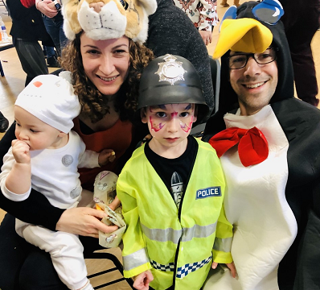
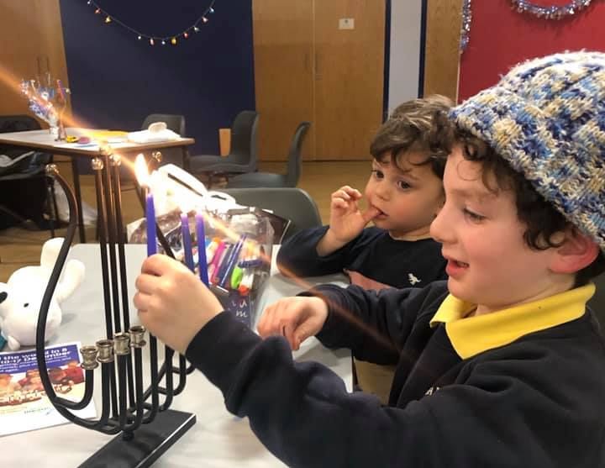
EHRS wider support for Jewish education
Offering Reform environment and learning, creative and non-judgemental
Reform community, from generation to generation
Young families activities and events
Supporting challenges with Jewish school SRE etc.
Youth clubs and holiday camps for fun and engaging Jewish life
Live your Jewish values with us at EHRS throughout the year
Membership offer for all new young families wishing to join EHRS

Slide 12
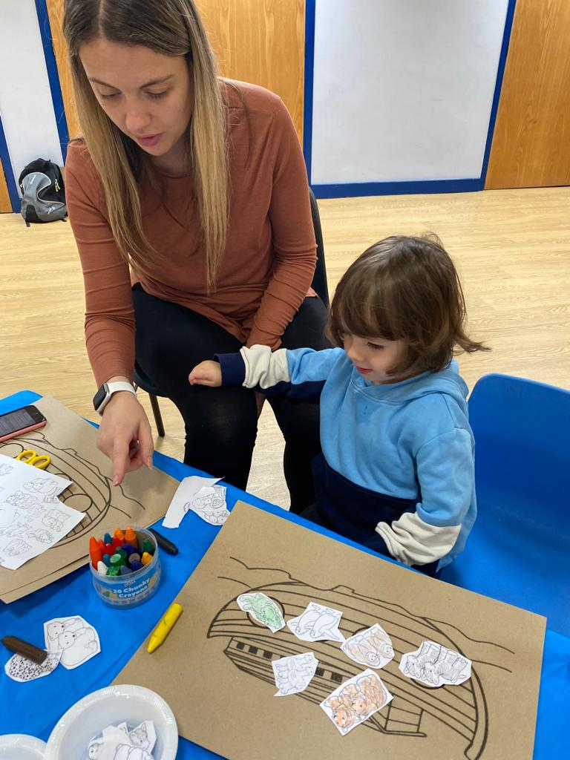
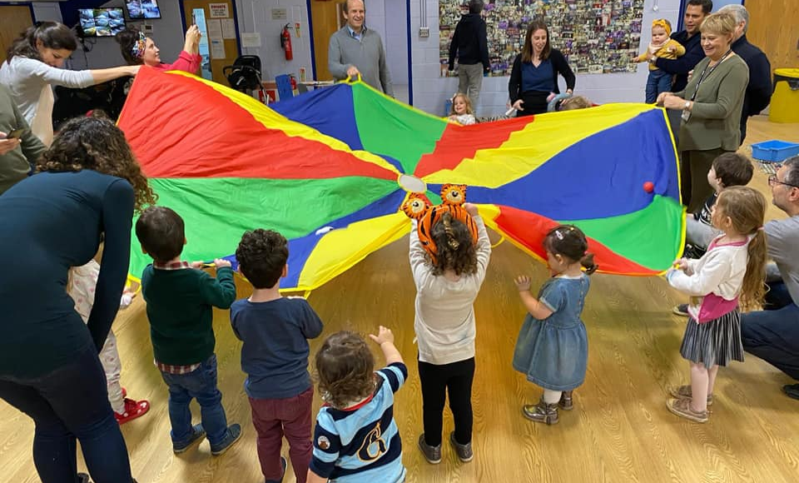
EHRS Young Families is our Facebook page specially dedicated to all who are starting their Jewish adventure with an under 8 in the family. It lists our events as they are planned.
Webpage - https://www.ehrs.uk/youngfamilies/
E-mail youngfamilies@ehrs.uk to receive weekly updates of all that’s going on.

Slide 13
Q&A
Contact:
sarah.koster@ehrs.uk youngfamilies@ehrs.uk

