Slide 1


Shabbat for the Soul 2 October 2021

Slide 2

“All new beginnings require that you unlock a new door”
Rebbe Nachman of Bratslav

Slide 3
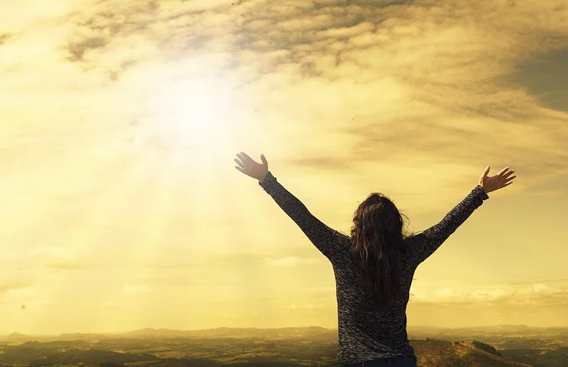
In Praise
GENESIS 1, 2
By RUTH F. BRIN
Hail the hand that scattered space with stars,
Wrapped whirling world in bright blue blanket, air,
Made worlds within worlds, elements in earth,
Souls within skins, every one a teeming universe,
Every tree a system of semantics, and pushed
Beyond probability to place consciousness
On this cooling crust of burning rock.
Oh praise that hand, mind, heart, soul, power or force
That so inclosed, separated, limited planets, trees, humans
Yet breaks all bounds and borders
To lavish on us light, love, life
This trembling glory.

Slide 4
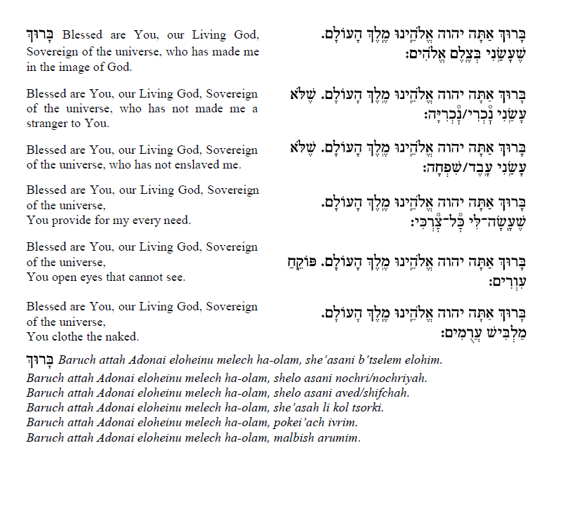

Slide 5


Slide 6
“In the beginning, for unknowable reasons, the ground of being, or the Divine, chose to give itself over to the chance and risk and endless variety of becoming. [...] in order that the world might be, and be for itself, God renounced his being, divesting himself of his deity - to receive it back from the Odyssey of time weighted with the chance harvest of unforeseeable temporal experience: transfigured or possibly even disfigured by it. In such self-forfeiture of divine integrity for the sake of unprejudiced becoming, no other foreknowledge can be admitted than that of possibilities which cosmic being offers in its own terms: to these, God committed his cause in effacing himself for the world. [...] The advent of man means the advent of knowledge and freedom, and with this supremely double edged gift the innocence of the mere subject of self-fulfilling life has given way to the charge of responsibility under the disjunction of good and evil.”
Jonas, H. (1968 (1999))“The Concept of God after Auschwitz” pp. 465-476 in Fridelander, A. (Ed.) (1968 (1999)) Out of the Whirlwind UAHC Press; New York

Slide 7
For the Beauty of the Earth:
https://www.youtube.com/watch?v=JVQFEgT7E6c

Slide 8
Nishmat by Marge Piercy
taken from ‘ The Art of blessing the day.’
When the night slides under with the last dimming star
And the red sky lightens between the trees,
And the heron glides tipping heavy wings in the river,
When crows stir and cry out their harsh joy,
And swift creatures of the night run toward their burrows,
And the deer raises her head and sniffs the freshening air,
And the shadows grow more distinct and then shorten.
Then we rise into the day still clean as new snow.
The cat washes its paw and greets the day with gratitude.
Leviathan salutes breaching with a column of steam.
The hawk turning the in the sky cries out a prayer like a knife.
We must wonder at the sky now thin as a speckled eggshell,
That now piles up its boulders of storm to crash down,
That now hangs a furry grey belly into the street.
Every day we find a new sky and a new earth
with which we are trusted like a perfect toy.
[…]
Let silence still us so you may show us your shining
And we can out of that stillness rise and praise.

Slide 9

P.206 in the siddur

Slide 11
When you dream of love, who or what do you dream of?

Slide 13
Siddur p.217

Slide 14
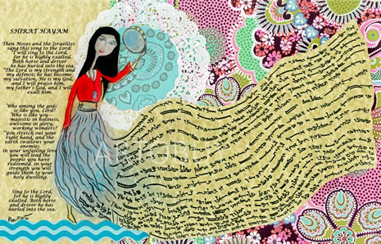

Slide 16
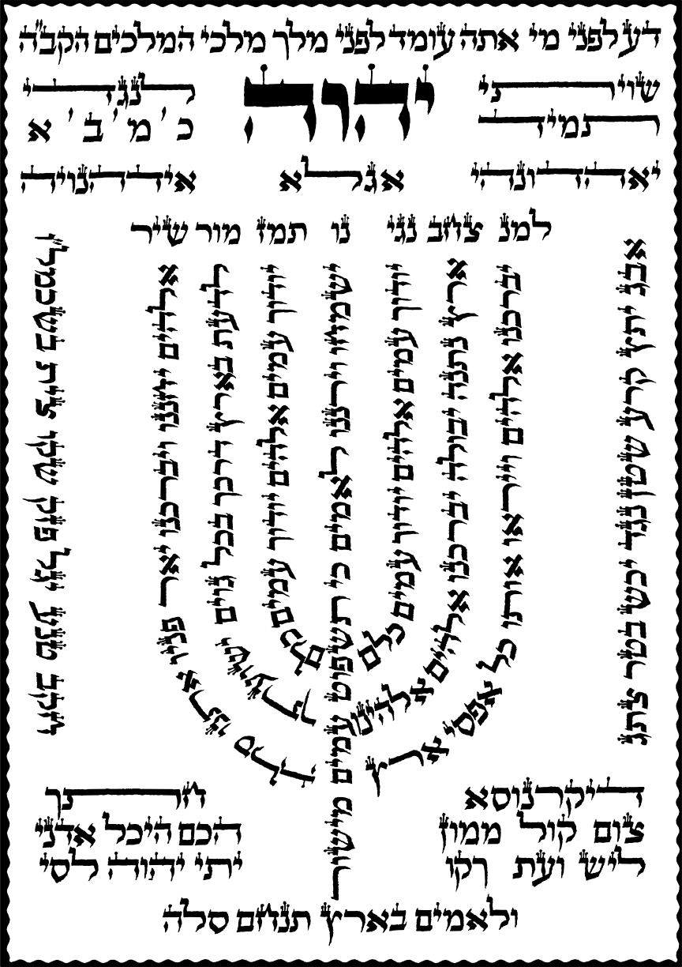
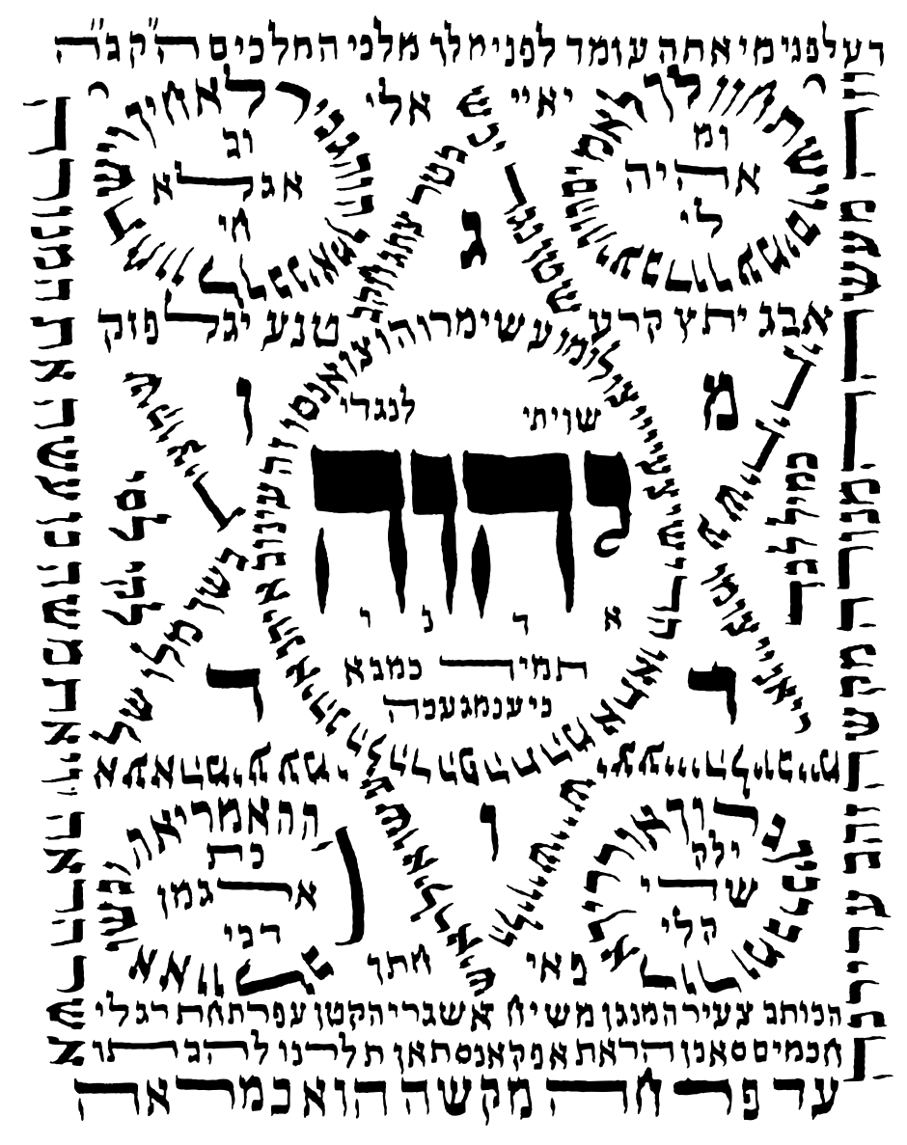
Amidah p.222 siddur
Shiviti by Asgari, circa late 19th – early 20th century Herat, Afghanistan

Slide 17
The Creation
James Weldon Johnson - 1871-1938
And God stepped out on space,
And he looked around and said:
I'm lonely—
I'll make me a world.
And far as the eye of God could see
Darkness covered everything,
Blacker than a hundred midnights
Down in a cypress swamp.
Then God smiled,
And the light broke,
And the darkness rolled up on one side,
And the light stood shining on the other,
And God said: That's good!
Then God reached out and took the light in his hands,
And God rolled the light around in his hands
Until he made the sun;
And he set that sun a-blazing in the heavens.
And the light that was left from making the sun
God gathered it up in a shining ball
And flung it against the darkness,
Spangling the night with the moon and stars.
Then down between
The darkness and the light
He hurled the world;
And God said: That's good!
Then God himself stepped down—
And the sun was on his right hand,
And the moon was on his left;
The stars were clustered about his head,
And the earth was under his feet.
And God walked, and where he trod
His footsteps hollowed the valleys out
And bulged the mountains up.
Then he stopped and looked and saw
That the earth was hot and barren.
So God stepped over to the edge of the world
And he spat out the seven seas—
He batted his eyes, and the lightnings flashed—
He clapped his hands, and the thunders rolled—
And the waters above the earth came down,
The cooling waters came down.
Then the green grass sprouted,
And the little red flowers blossomed,
The pine tree pointed his finger to the sky,
And the oak spread out his arms,
The lakes cuddled down in the hollows of the ground,
And the rivers ran down to the sea;
And God smiled again,
And the rainbow appeared,
And curled itself around his shoulder.
Then God raised his arm and he waved his hand
Over the sea and over the land,
And he said: Bring forth! Bring forth!
And quicker than God could drop his hand,
Fishes and fowls
And beasts and birds
Swam the rivers and the seas,
Roamed the forests and the woods,
And split the air with their wings.
And God said: That's good!
Then God walked around,
And God looked around
On all that he had made.
He looked at his sun,
And he looked at his moon,
And he looked at his little stars;
He looked on his world
With all its living things,
And God said: I'm lonely still.

Slide 18
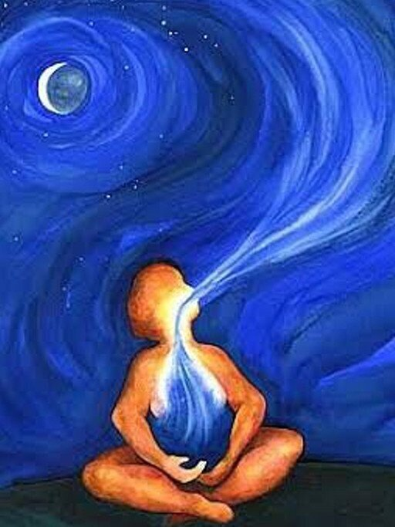
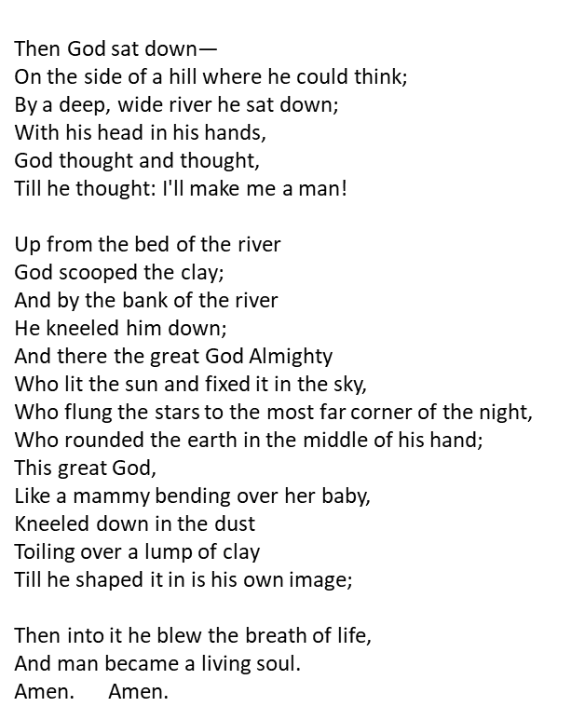

Slide 19
Siddur p.310

Slide 21
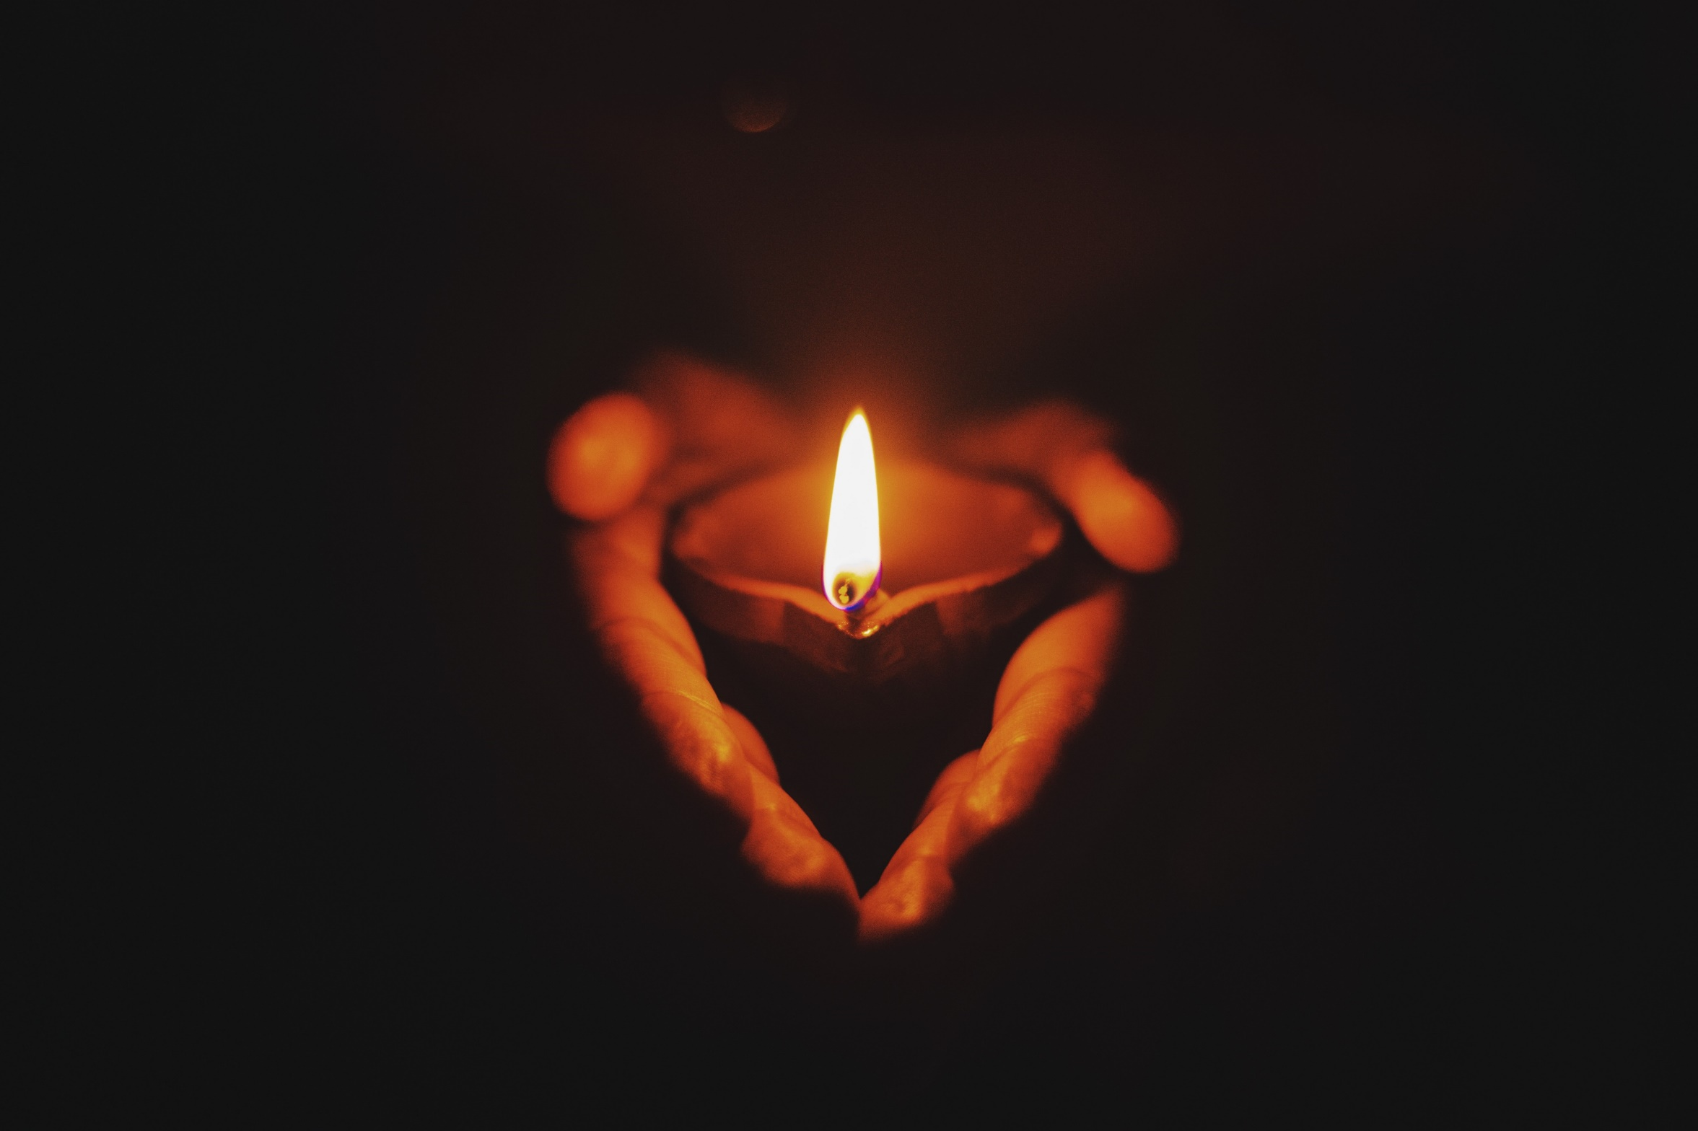

Slide 22
Yitgadal, v’yitkadash,sh’meih raba, b’alma divra chiruteih, v’yamlich malchuteih, b’chayeichon uv’yomeichon uv’chayei d’chol beit Yisra’eil, ba’agala uviz’man kariv. V’im’ru: amein. Y’hei sh’meih raba m’varach l’alam ul’almei almaya. During the Ten Days of Penitence, add the words in parenthesis: Yitbarach, v’yishtabach, v’yitpa’ar, v’yitromam, v’yitnasei, v’yit’hadar, v’yitaleih, v’yit’halal sh’meih d’kud’sha. B’rich hu l’eila (ul’eila) min kol bir’chata, v’shirata, tushb’chata, v’nech’mata, da’amiran b’alma. V’im’ru: amein. Y’hei sh’lama raba min sh’maya v’chayim aleinu v’al kol Yisra’eil. V’imru: amein. Oseh shalom bim’romav, hu ya’aseh shalom, aleinu v’al kol Yisra’eil. V’al kol ha’olam. V’im’ru: amein.

Slide 25
